Slide 1
JPEG2000 Tiles, Subbands, Resolution Levels, Precincts, Code Blocks, etc.
M. A. Mayer
4/11/21

Slide 2
Image Partitioning (including subbanding)

Slide 3

Reference Grid and Image Area
Every component, tile, subband, etc. is registered with the overall image via the reference grid.
The reference grid is nothing more than the global coordinate system.
It defines the origin (0,0)
It defines the base spatial axes
Origin is located at top-left corner of the grid
Increasing X values (columns) go from left to right
Increasing Y values (rows) go from top to bottom
The Image Area is the portion of the reference grid
that contains imagery
SIZ marker defines the image area
Upper left = (XOsiz,YOsiz)
Lower right = (Xsiz, Ysiz)
(0,0)
(0,0)
(XOsiz,YOsiz)
(Xsiz-1,Ysiz-1)

Slide 4
Components
A component is exactly that---a self-contained part of the image.
This is an intentionally vague definition. It allows for whatever use is needed.
The common theme is that an image is a composite of one or more of its components
Examples:
Red, Green, Blue bands of an RGB image
Alpha component as transparency mask
SIZ marker segment
Each component is same size and location as
the image area
Pixel spacing (XRsiz,YRsiz) may be different
for each component
RGB Image
(3 components)
Red
Green
Blue

Slide 5
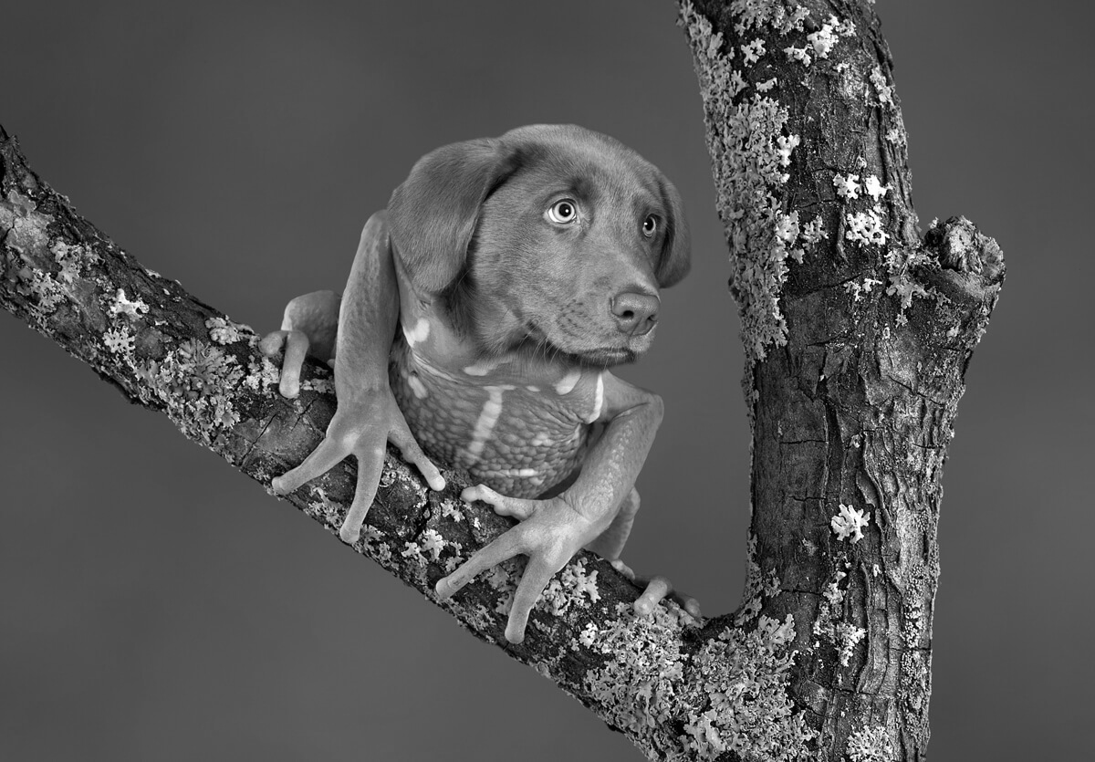
Tiles
Tiles are used to segment the image for compression
The conversion of image pixels to a JPEG2000 code-stream occurs at the tile level
The same tiling is used for every component
The tiling
need not span the entire reference grid
must span the entire image area
need not contain the reference grid origin
All tiles
are of the same size
must overlap the image area
Tiles are numbered in raster order
SIZ marker segment
Upper left of 1st tile = (XTOsiz,YTOsiz)
Tile size = (XTsiz,YTsiz)
Tile 0
Tile 1
Tile 2
Tile 3
Tile 4
Tile 5
Tile 6
Tile 7
Tile 8

Slide 6
Tile Corner Coordinates
Relative to Reference Grid
Number rows/columns in the tile grid
Tile column (p), row (q), and grid (t) indices:
Upper left corner grid coordinates for each tile
Lower left corner grid coordinates for each tile
Relative to Component
Reference grid coordinates scaled by the component pixel spacing
$$N_{tile columns}=ceil\left(\frac{X_{siz}−{XTO}_{siz}}{{XT}_{siz}}\right){ N}_{tile rows}=ceil\left(\frac{Y_{siz}−{YTO}_{siz}}{{YT}_{siz}}\right)$$
$$p=mod\left(t, N_{tile columns}\right) q=floor\left(\frac{t}{N_{tile columns}}\right) t=p+q{ N}_{tile columns}$$
$${tx}_{0}\left(p,q\right)={XTO}_{siz}+p {XT}_{siz}{ ty}_{0}\left(p,q\right)={YTO}_{siz}+q {YT}_{siz}$$
$${tx}_{1}\left(p,q\right)={XTO}_{siz}+(p+1) {XT}_{siz}{ ty}_{1}\left(p,q\right)={YTO}_{siz}+(q+1) {YT}_{siz}$$
${tcx}_{0}=ceil\left(\frac{{tx}_{0}}{{XR}_{siz}^{c}}\right) {tcy}_{0}=ceil\left(\frac{{ty}_{0}}{{YR}_{siz}^{c}}\right)$ ${tcx}_{1}=ceil\left(\frac{{tx}_{1}}{{XR}_{siz}^{c}}\right) {tcy}_{1}=ceil\left(\frac{{ty}_{1}}{{YR}_{siz}^{c}}\right)$

Slide 7
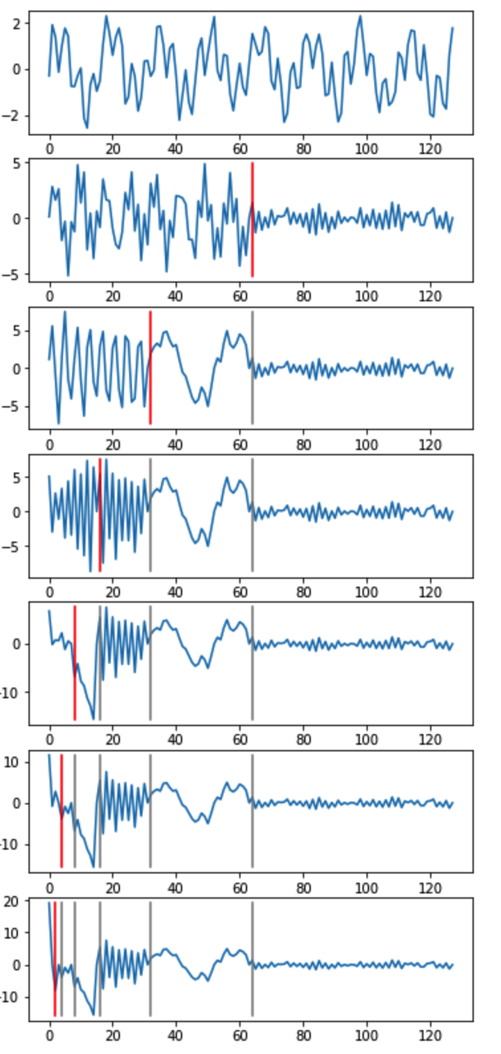
Discrete Wavelet Transform (DWT)
Before going on to Subbands, we need to discuss the DWT
The DWT splits a signal into high and low frequency signals
The new signals each contain half as many samples as the original signal
The low frequency signal contains the coarse form of the original signal
The high frequency signal contains refining detail
Subsequent DWT iterations can be applied to the low frequency signal
Results in a lower fidelity signal that still preserves the coarse form of the original signal + a new level of high frequency refinement
Reconstruction of the original signal can be accomplished with Inverse DWT
Exact reconstruction is possible with lossless wavelet
Reasonable facsimile is possible with a lossy wavelet

Slide 8
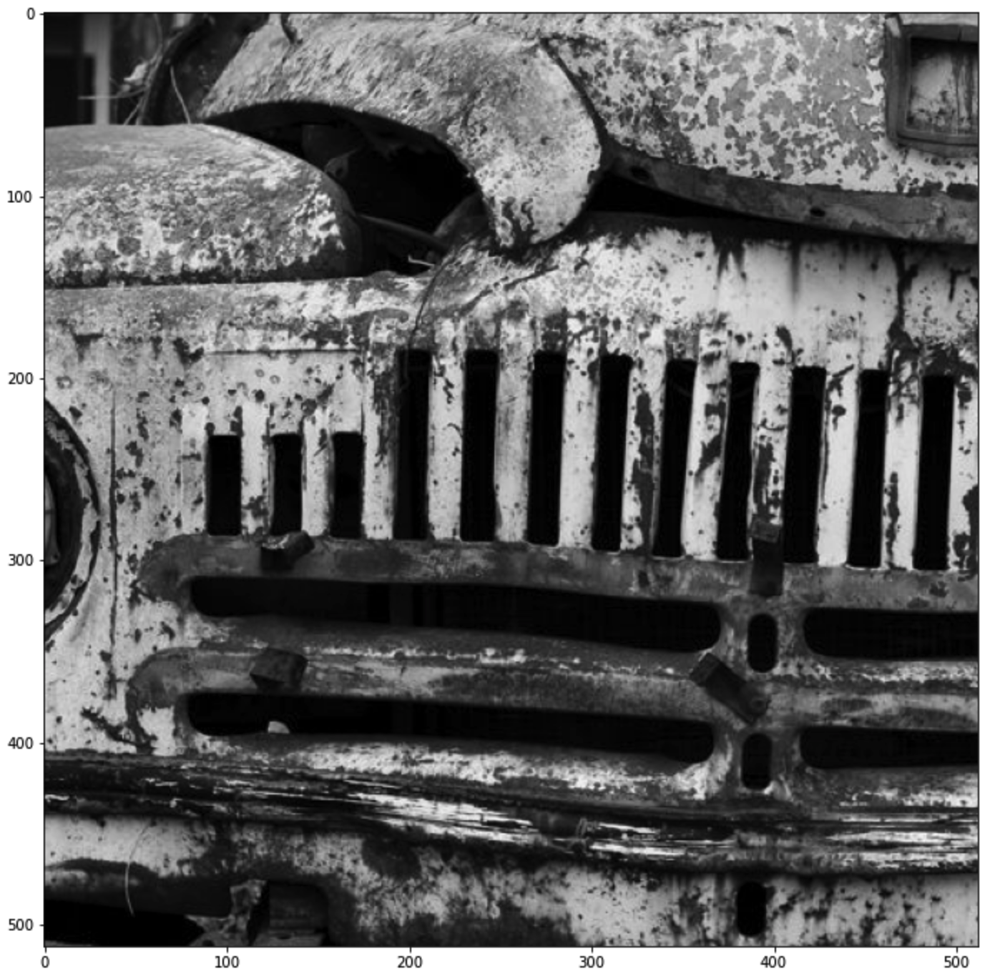
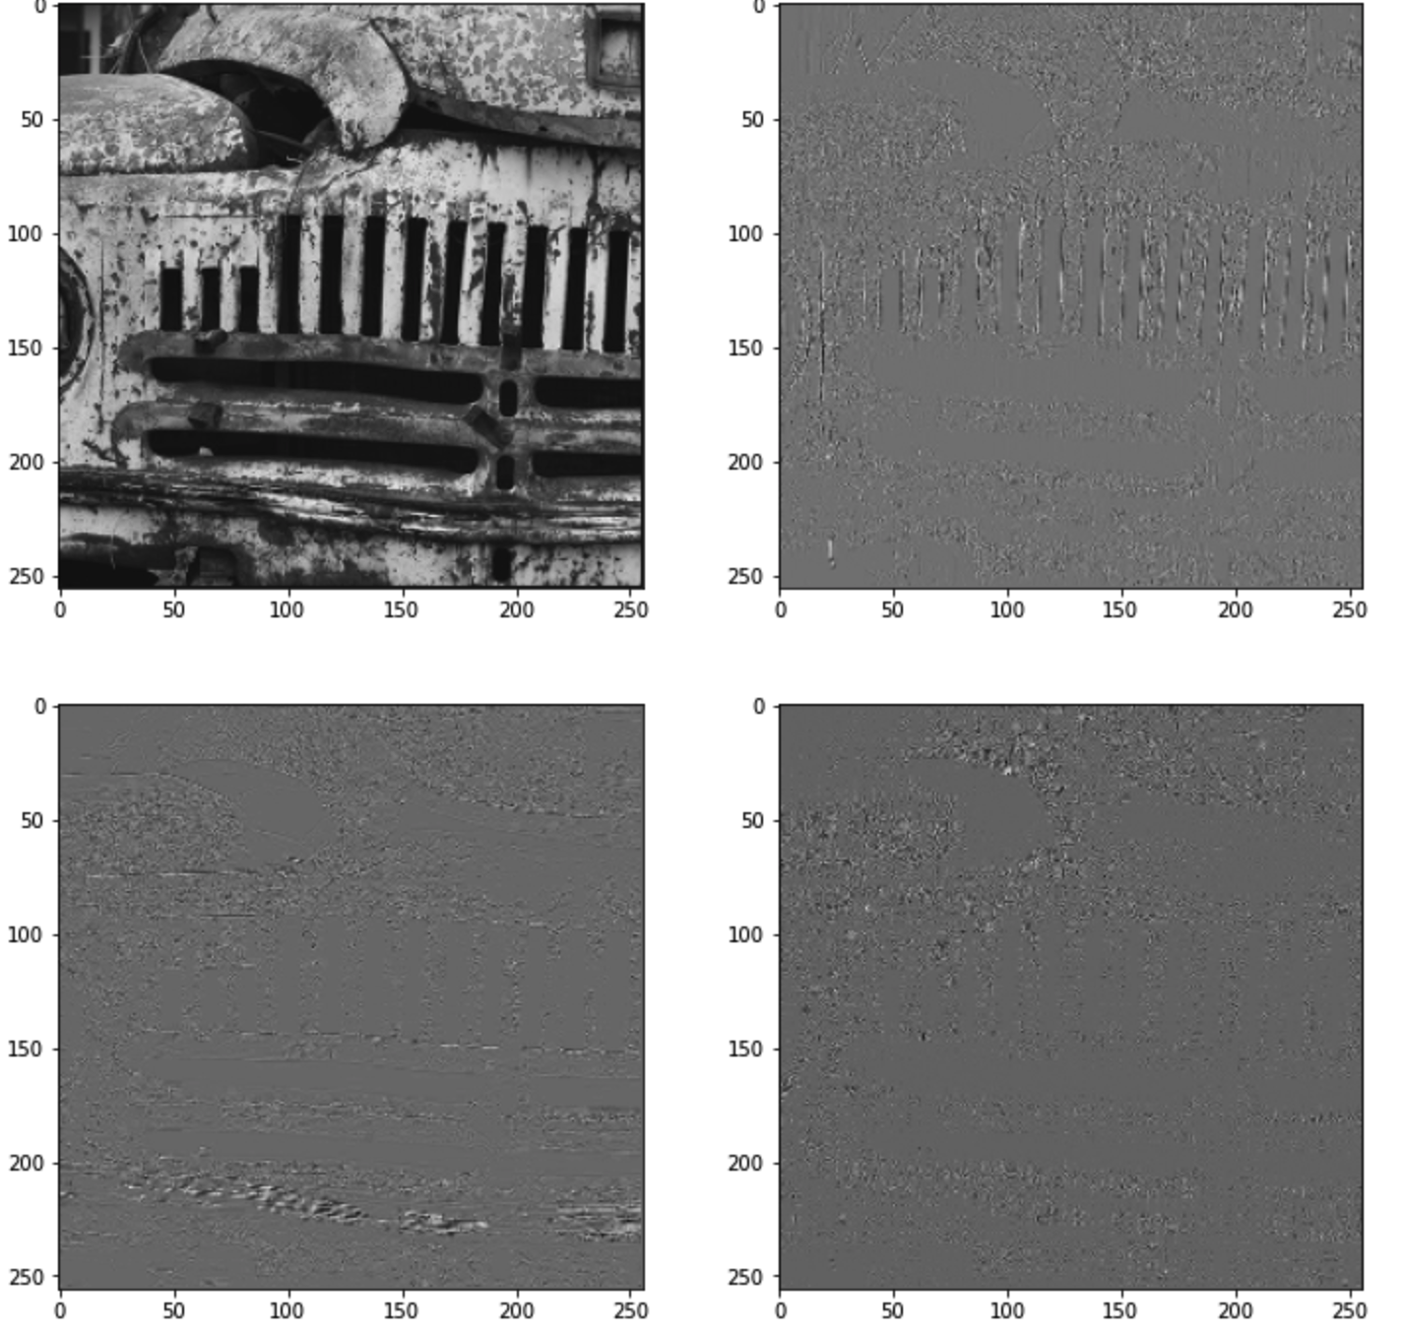
2-Dimensional DWT
DWT of a 2D image is accomplished by two passes
First pass applies DWT to each row
Second applies DWT to each row
Result is 4 new 2D ”images” commonly labeled as LL, HL, LH, HH
L=low frequency, H=high frequency
1st letter = horizontal band, 2nd letter = vertical band

Slide 9
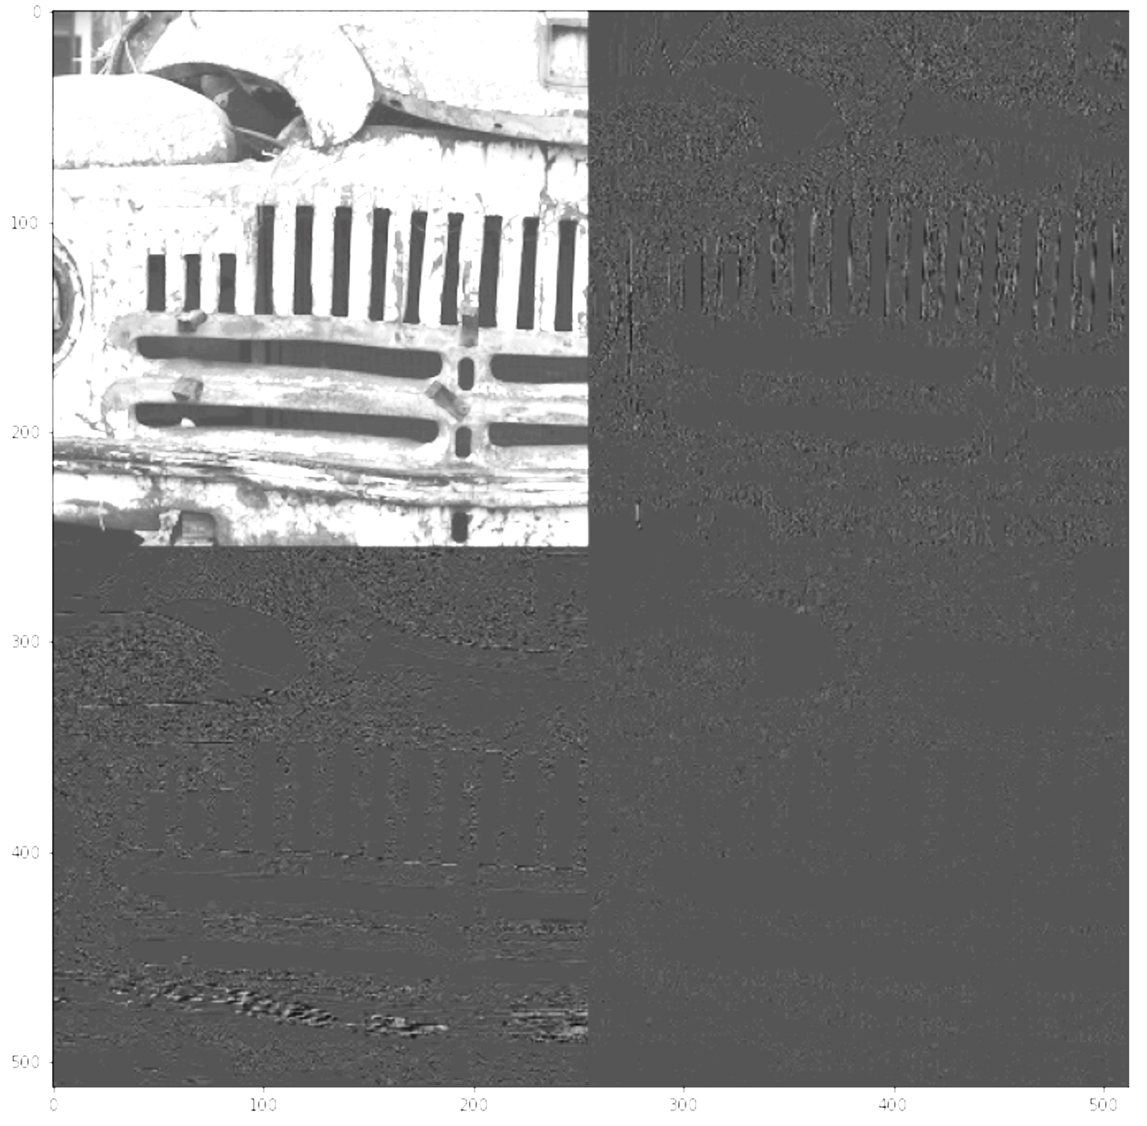
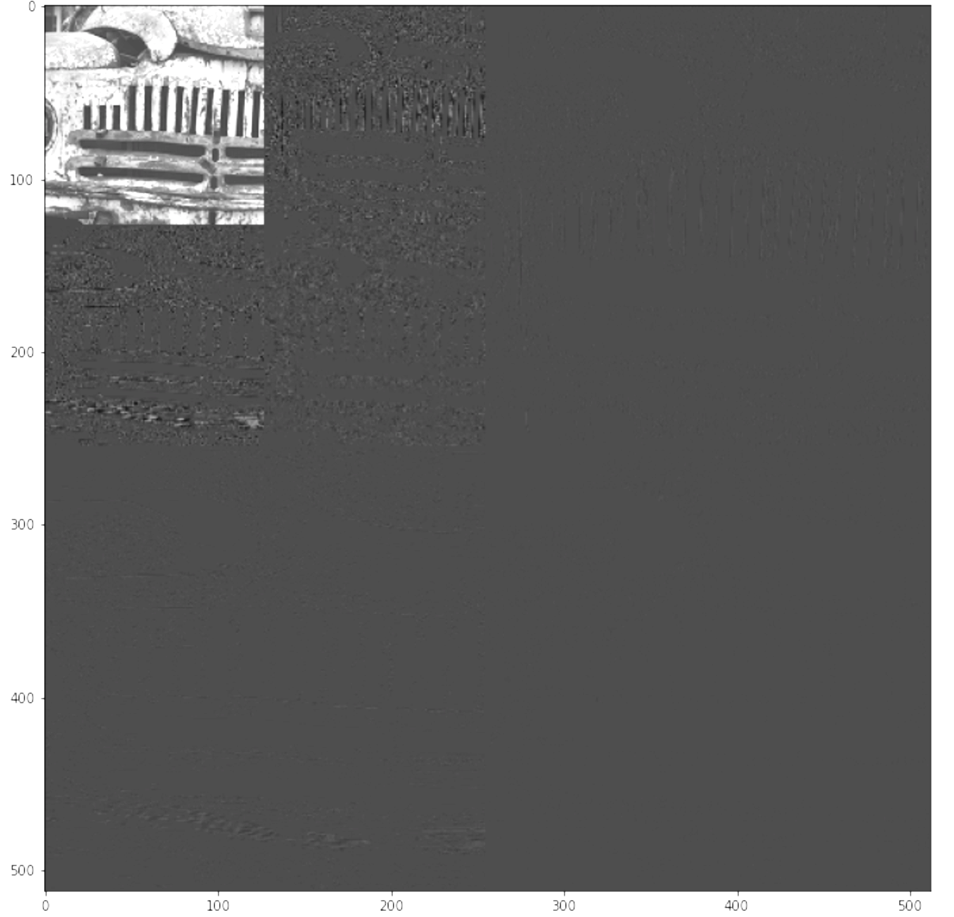
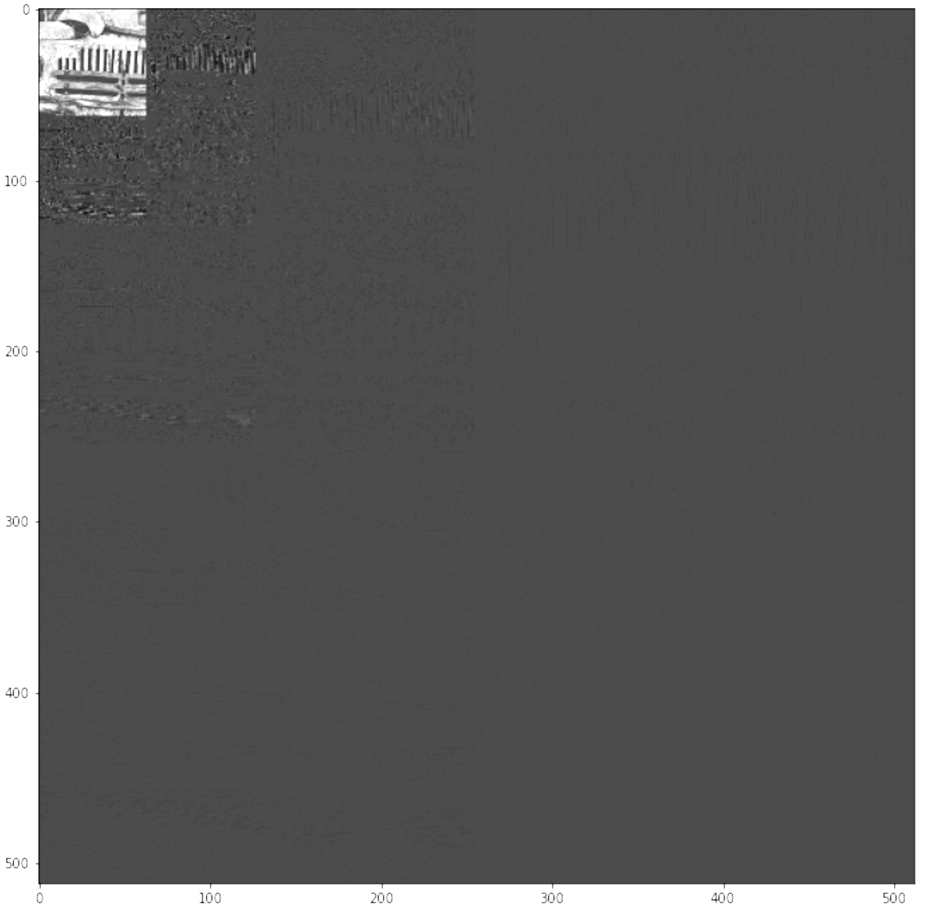
Subbands, Decomposition and Resolution Levels
Subbands are result of recursive DWT (discrete waveform transforms)
Commonly shown composited into a single image
The resolution level is related to the DWT iteration count
The current DWT iteration is also known as the decomposition level (n_{b})
The original image is decomposition level 0
The final iteration is decomposition level N_{L}
The resolution level (r) is simply N_{L} – n_{b}
Subbands are labeled using decomposition level and 2D frequency band
Only LL subband that appears in JPEG2000 code-stream is N_{L}LL
All others can be reconstructed from subsequent resolution level subbands
N_{L}=1
N_{L}=2
N_{L}=3
3LL
3HL
2HL
3LH
3HH
1HL
2LH
2HH
1LH
1HH

Slide 10
Tile Corner Coordinates (again)
Relative to Resolution Level
Component coordinates scaled for resolution level spacing
Mapping between subbands and tiles
Each resolution level cuts the number of samples by factor of 2
Physically, subband corners map to to tile corners
Together, these are equivalent to
Tile corner coordinates in resolution level coordinates (r)
${trx}_{0}=ceil\left(\frac{{tcx}_{0}}{2^{N_{L}−r}}\right) {try}_{0}=ceil\left(\frac{{tcy}_{0}}{2^{N_{L}−r}}\right)$ ${trx}_{1}=ceil\left(\frac{{tcx}_{1}}{2^{N_{L}−r}}\right) {try}_{1}=ceil\left(\frac{{tc y}_{ 1}}{2^{N_{L}−r}}\right)$

Slide 11
Precincts
Precincts are used to partition tiles at the resolution level
precinct grid origin is coincident with the reference grid origin
precinct dimensions = 2^{PPx} x 2^{PPy}
precincts don’t necessarily align with tiles
PPx and PPy can be uniquely specified for
each tile, component, and resolution level
At r = 0, PPx and PPy may be 0
At all other r, PPx and PPy must be > 0
COD markers
Scod/SPcod define default (PPx,PPy)
Can be specified at either file or tile level
COC markers
Scoc/SPcoc define component (PPx,PPy) and
may include distinct values for each resolution level
Can be specified at either file or tile level
2^{PPx}
2^{PPy}
K0
K1
K2
K3
K4
K5

Slide 12
Code Blocks
Code blocks are used to partition tiles for coding DWT coefficients
code block grid origin is coincident with the reference grid origin
code block dimensions = 2^{xcb’} x 2^{ycb’}
Precincts contain one or more complete code blocks
xcb’ = min{ xcb, PPx-1 } for r > 0
xcb’ = min {xcb, PPx } for r=0
ycb’ = min{ ycb, PPy-1 } for r > 0
ycb’ min {ycb, PPy } for r=0
xcb and ycb can be specified differently for each tile and component
COD markers
SPcod define default (xcb,ycb)
Can be specified at either file or tile level
COC markers
SPcoc define component (xcb,ycb)
Can be specified at either file or tile level
code block
precinct

Slide 13
Code-Stream Formation

Slide 14
Modified SIZ marker for a single tile

Slide 15
SIZ fields when all tiles are present
SIZ fields under consideration
(XOsiz, YOsiz) – upper left corner of image area
(Xsiz, Ysiz) – lower left right of image area
(XTOsiz, YTOsiz) – upper left corner of first tile
(XTsiz, YTsiz) - dimensions of a single tile
Image area cannot extend beyond tiles
Determines number of tile rows/columns
(XTOsiz, YTOsiz)
(XOsiz, YOsiz)
Tile 0
(0,0)
Tile 1
(1,0)
Tile 2
(2,0)
Tile 3
(0,1)
Tile 4
(1,1)
Tile 5
(2,1)
Tile 6
(0,2)
Tile 7
(1,2)
Tile 8
(2,2)
(Xsiz, Ysiz)
(XTOsiz + 3XTsiz, YTOsiz + 3YTsz)

Slide 16
SIZ fields for Tile 0
Image area needs to be restricted to tile of interest
Upper Left corner of image area is ok
Lower Right corner of image area
Xsiz_{new} = XTOsiz + XTsiz
Ysiz_{new} = YTOsiz + YTsiz
Upper Left corner of first tile is ok
(XTOsiz, YTOsiz)
(XOsiz, YOsiz)
Tile 0
(0,0)
(XTOsiz + XTsiz, YTOsiz + YTsiz)

Slide 17
SIZ fields for Tile 1
Image area needs to be restricted to tile of interest
Upper Left corner of image area
XOsiz_{new} = XTOsiz + XTsiz
YOsiz_{new} = YOsiz
Lower Right corner of image area
Xsiz_{new} = XTOsiz + 2XTsiz
Ysiz_{new} = YTOsiz + YTsiz
Upper Left corner of first tile
XTOsiz_{new} = XTOsiz + XTsiz
YTOsiz_{new} = YTOsiz
(XTOsiz+XTsiz, YTOsiz)
(XTOsiz + XTsiz, YOsiz)
Tile 1
(0,1)
(XTOsiz + 2XTsiz, YTOsiz + YTsiz)

Slide 18
SIZ fields for Tile 2
Image area needs to be restricted to tile of interest
Upper Left corner of image area
XOsiz_{new} = XTOsiz + 2XTsiz
YOsiz_{new} = YOsiz
Lower Right corner of image area
Xsiz_{new} = Xsiz
Ysiz_{new} = YTOsiz + YTsiz
Upper Left corner of first tile
XTOsiz_{new} = XTOsiz + 2XTsiz
YTOsiz_{new} = YTOsiz
(XTOsiz+2XTsiz, YTOsiz)
(XTOsiz + 2XTsiz, YOsiz)
Tile 2
(0,2)
(Xsiz, YTOsiz + YTsiz)

Slide 19
SIZ fields for Tile 8
Image area needs to be restricted to tile of interest
Upper Left corner of image area
XOsiz_{new} = XTOsiz + 2XTsiz
YOsiz_{new} = YTOsiz + 2YTsiz
Lower Right corner of image area is ok
Upper Left corner of first tile
XTOsiz_{new} = XTOsiz + 2XTsiz
YTOsiz_{new} = YTOsiz + 2YTsiz
(XTOsiz+2XTsiz, YTOsiz)
(XTOsiz + 2XTsiz, YTOsiz + 2YTsiz)
Tile 8
(2,2)
(Xsiz, Ysiz)

Slide 20
SIZ fields for Tile with indices (p,q)
Image area needs to be restricted to tile of interest
Upper Left corner of image area
XOsiz_{new} = Max{ XOsiz, XTOsiz + p * XTsiz }
YOsiz_{new} = Max{ YOsiz, YTOsiz + q * YTsiz }
Lower Right corner of image area
Xsiz_{new} = Min{ Xsiz, XTOsiz + (p+1) * XTsiz }
Ysiz_{new} = Min{ Ysiz, YTOsiz + (q+1) * YTsiz }
Upper Left corner of first tile
XTOsiz_{new} = XTOsiz + p * XTsiz
YTOsiz_{new} = YTOsiz + q * YTsiz

